Slide 1
Cybersecurity
Denial of Service

Slide 2
Denial of Service
Causes some service to be inaccessible
Overloaded server
Exploit weakness or design flaw
Prevent communication
Autocratic governments cut internet connections to stifle dissent
Create distraction for another exploit
Take one system offline so nobody notices attacking the other system
Doesn’t have to be complicated
Jam the signal
Cut the cable
Kill power

Slide 3
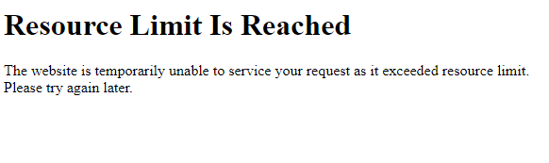
Non-malicious DoS
Unintentional DoS
Slashdot, Digg, Reddit give the “hug of death”
Too many visitors to small web server, overloads it
When sites go viral on social media and can’t handle it
Too much love!
Digging up cable
Power outage at data center
Network DoS
Layer 2 loop without Spanning Tree Protocol (STP)

Slide 4
Distributed Denial of Service (DDoS)
Coordinated effort across legions of computers
Too much demand for server
Malicious actors use botnets
Thousands/millions ready to attack
Coordinated attack: small traffic/load for each individual member but HUGE problem for recipient
Asymmetric threat
The attacker may have fewer resources than the victim
SYN floods are simplistic but do not require a lot of resources
Slow Loris DoS can tie up very robust servers from a simple device

Slide 5
DDoS Amplification
Turn small attack into big attack
Often reflected off another device or service
Increasingly popular DDoS technique
Turn internet services networks against the victim
Small requests but results are sent to victim
“What’s the IP address of google.com?” (but send results to her)
…a few hundred thousand times a second
Like sending undeliverable mail via the post office with a different return address – the “victim” would be the person at the return address*
Utilize insecure, unauthenticated protocols
e.g. NTP, DNS, ICMP
A common example of protocol abuse
*Mail fraud is a serious federal crime you don’t want to learn about!

Slide 6

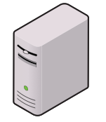

NTP Amplification
Botnet Master
Ask those time servers “What time is it?” But make the return come from that target.
Botnet Member
DoS Target
NTP Servers

Slide 7
NTP Amplification
Botnet Master
Ok boss.
Botnet Member
DoS Target
NTP Servers

Slide 8
NTP Amplification
Botnet Master
Spoofed request
Time?
Botnet Member
DoS Target
NTP Servers

Slide 9
NTP Amplification
Botnet Master
Time?
Spoofed request
Botnet Member
DoS Target
NTP Servers

Slide 10
NTP Amplification
Botnet Master
Time?
Spoofed request
Botnet Member
DoS Target
NTP Servers

Slide 11
NTP Amplification
Botnet Master
Time?
Time?
Botnet Member
DoS Target
Time?
NTP Servers

Slide 12
NTP Amplification
MANY more servers MANY MANY more responses
Botnet Master
Ow.
Time?
Time?
Time?
Botnet Member
DoS Target
NTP Servers

Slide 13
Amplifications
Amplification DoS can occur with most any protocol that is not authenticated
ICMP requests (ping) can be spoofed to return results to a target rather than the original requestor
DNS requests can be spoofed to return results to a target rather than the original requestor
Worse still, a lengthy DNS record like a security key or other TXT record can return more data than a simple IP address. This can increase impact of a DoS when using DNS!

